Slide 1
House Price Prediction
Jyoti Trivedi

Slide 2

Objective
Predict house prices using machine learning models

Slide 3
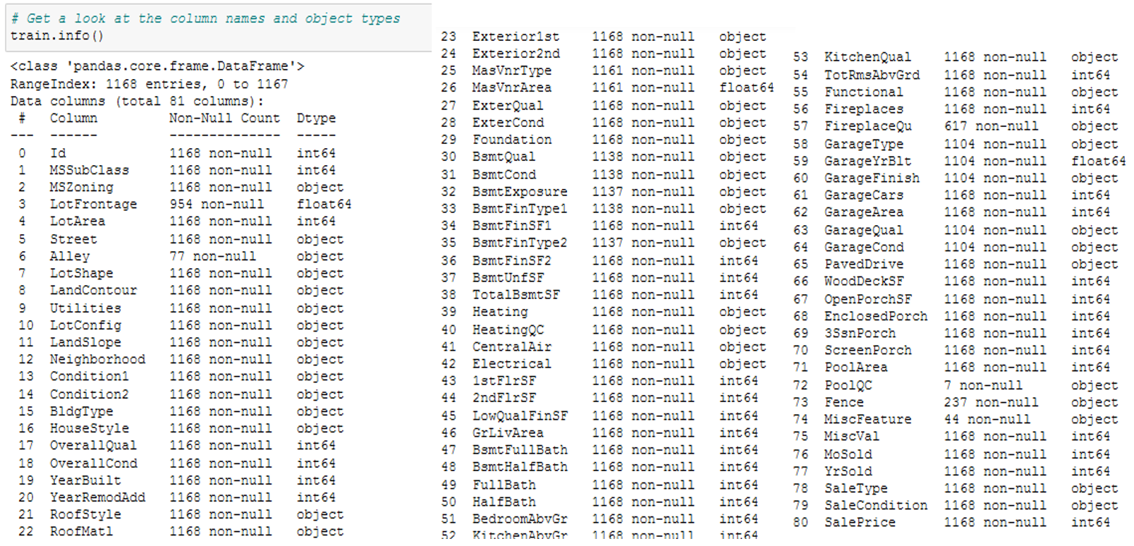
Data
CSV file containing details of the dataset and excel with description of all the attributes
Attributes:

Slide 4
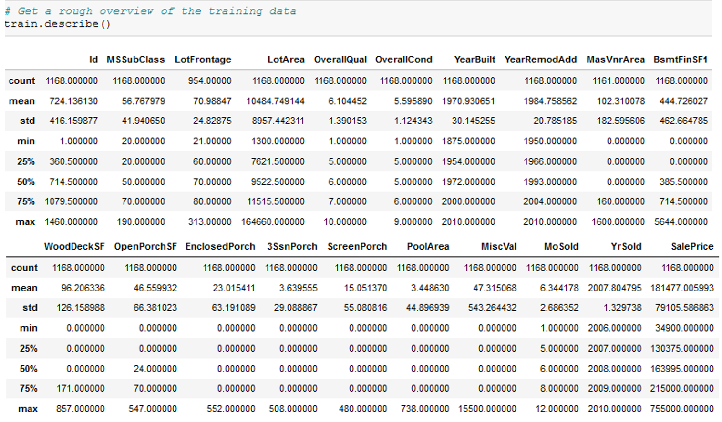
Basic statistical measures
There are missing values
The Q1, Q2, Q3 (25%, 50%, 100%) are good indicators of the shape of the different attribute.
The Q2 being the median that is not influenced by outliers unlike the mean.
According to the max values, there are obviously outliers
The standard deviation gives also an indication about what should be considered as outliers, but it is not a robust technique since the standard deviation use the mean to be computed.

Slide 5
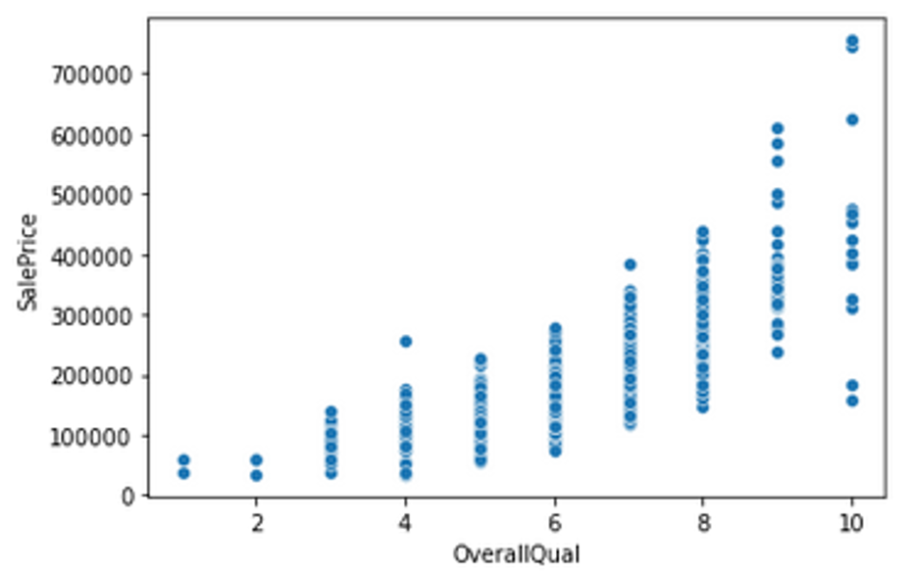
Visualizing the Data
Scatter plot gave a better idea of how variables are distributed.
Significant linear correlation between target variable and OverallQual

Slide 6
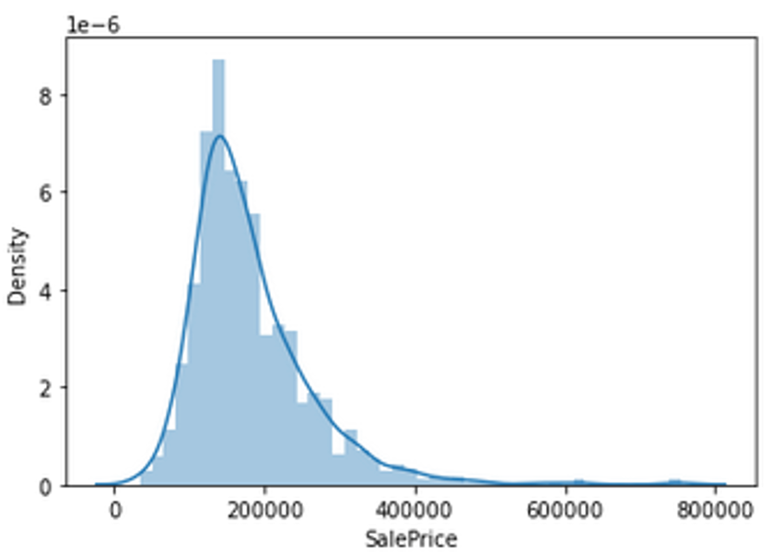
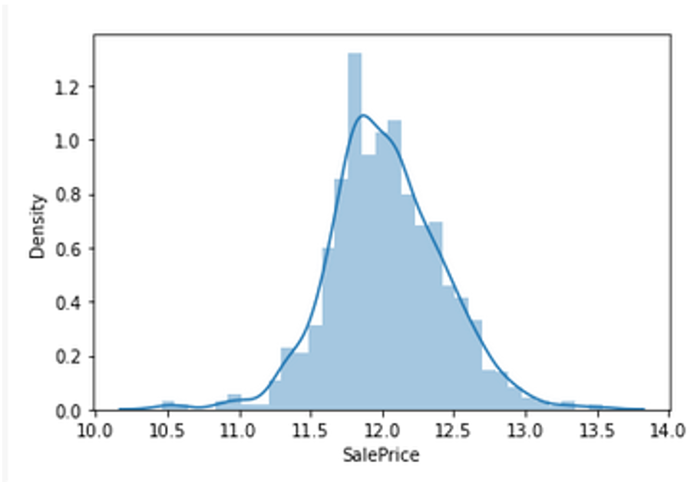
Visualizing the Data
Log Transformation
Skewed data
Normal distribution

Slide 7
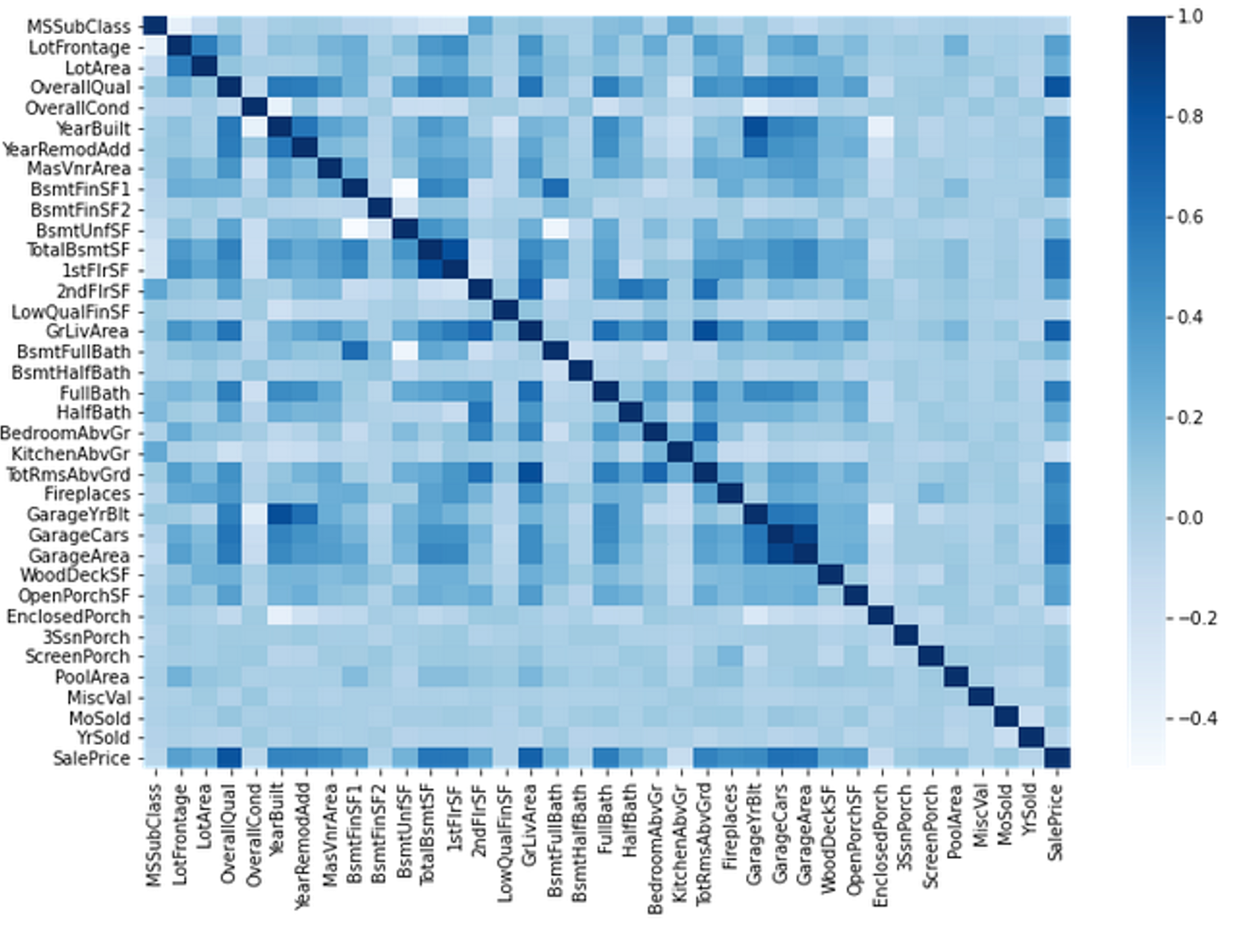
Correlation analysis and redundancies
Exploring the Linear Correlation between Features is helpful since it can:
· Highlight which features look to be the most useful for predicting the target variable
· Shed some light on which features are highly correlated together in which case they could be mutually redundant (this helps in Feature Selection)
We find that the two features OverallQual and GrLivArea are the most linearly correlated with our target so we can choose to explore them a bit further.

Slide 8
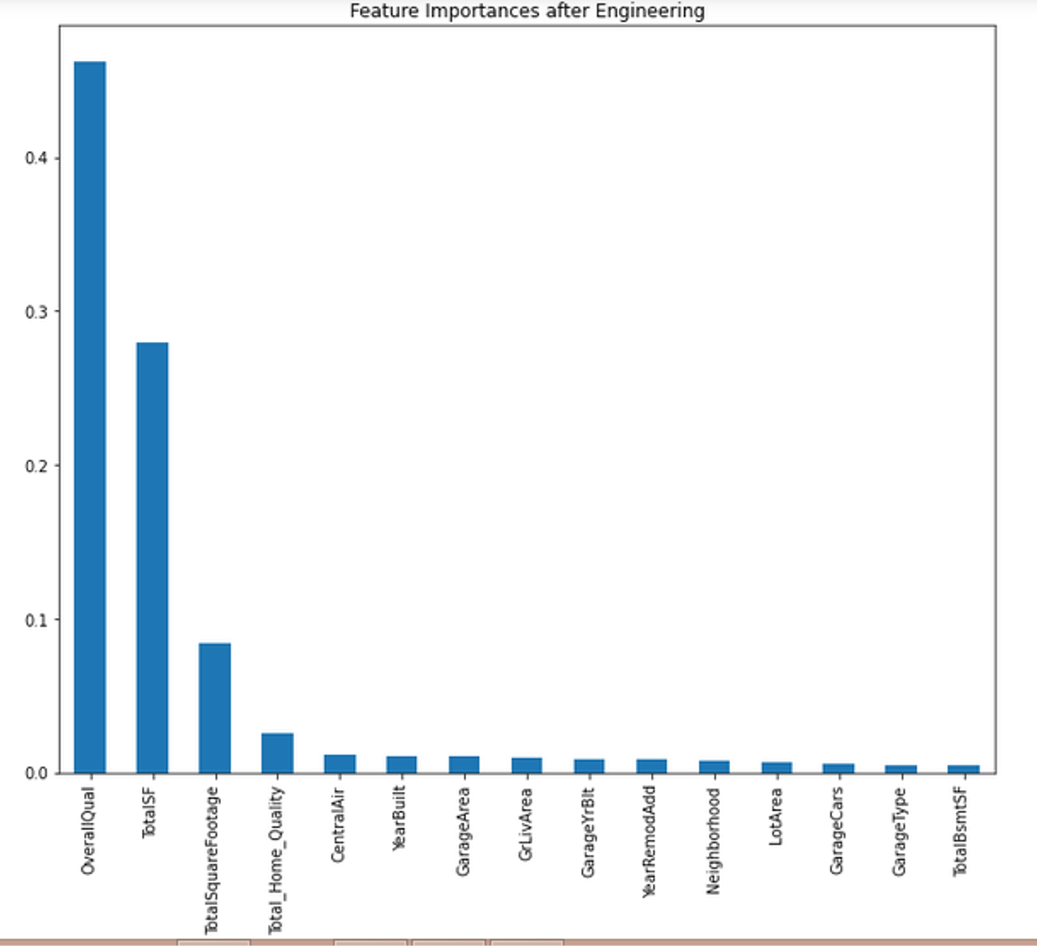
Feature selection
By applying the Feature engineering on the same model there is a chance to increase the performance from 70% to more
Three of our aggregated features are among the best that can be used for predicting the Target Variable
The OverallQual feature still reigns the highest and by a significant margin at that. Other than that we can also see the YearBuilt feature among the top predictors which implies that the later a house was built, the price tended to increase a lot more.
Another interesting note is that there are no Basement related features in this top-15 list, but there are a number of Garage related features. This could imply that in practice, Garages are more valuable than Basements which makes sense.

Slide 9
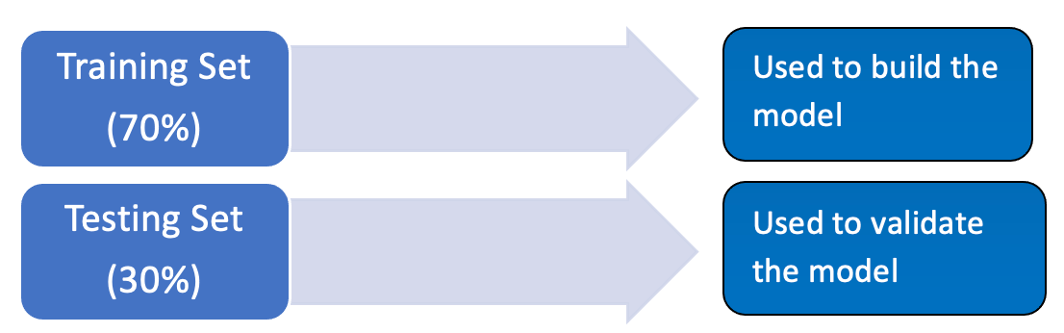
Machine Learning
TRAINING SET : train the learning algorithm TEST SET : validate model and make optimization
As the model is built from the training set, we can’t check it on the same set because the result would be overly optimistic.
The test set is used only to see how well the learning algorithm is generalized, meaning how it performs with unknown data

Slide 10
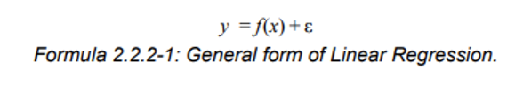
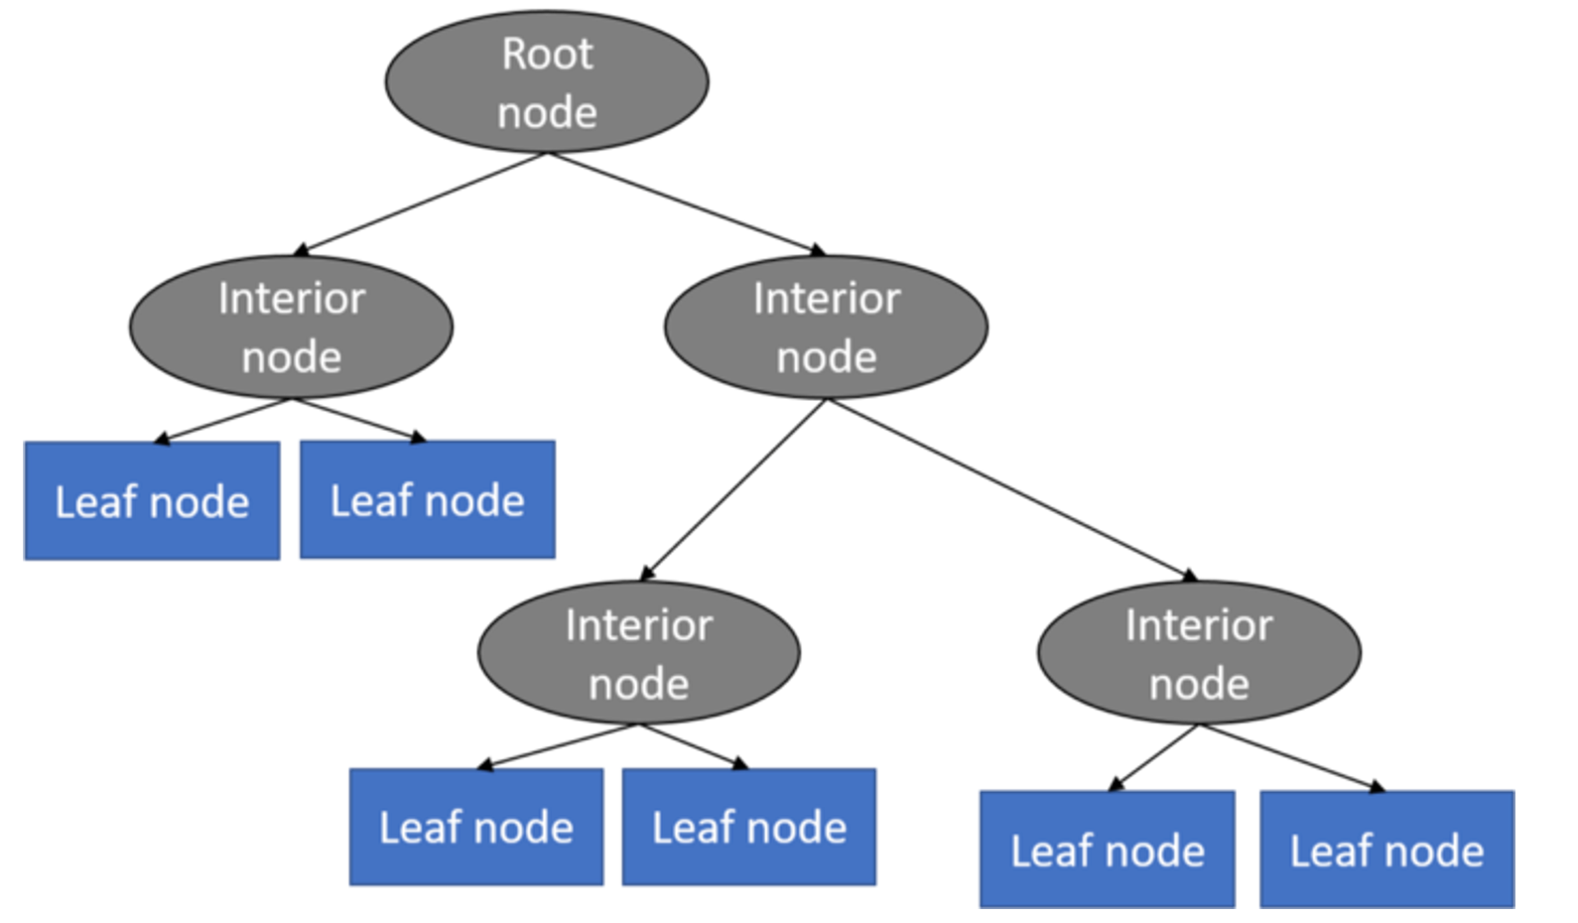
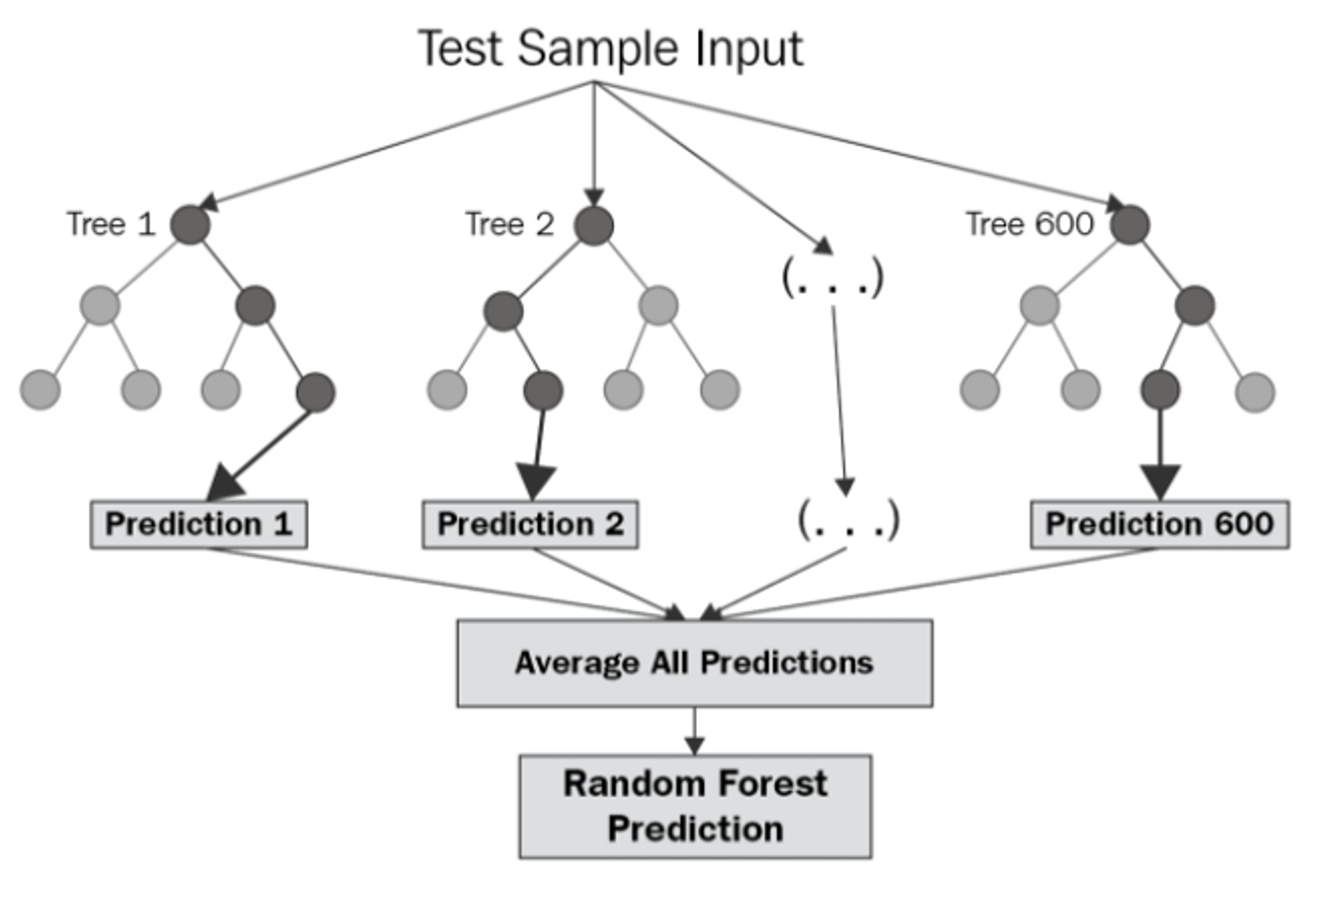
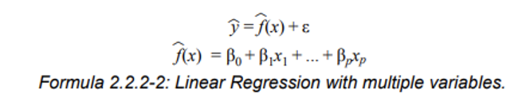
Learning Algorithm
Linear Regression
2. Decision Tree Regression
3. Random Forest Regression

Slide 11
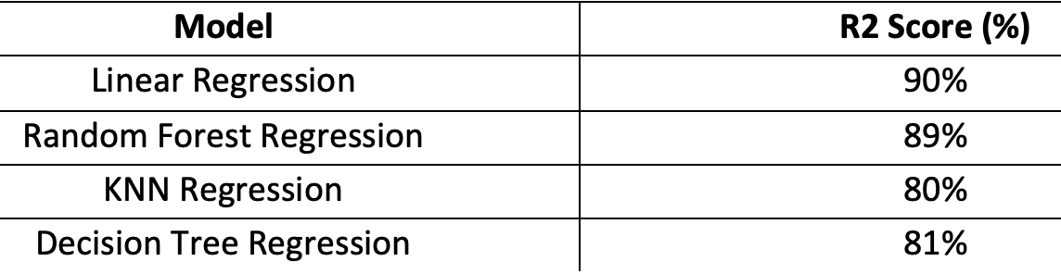
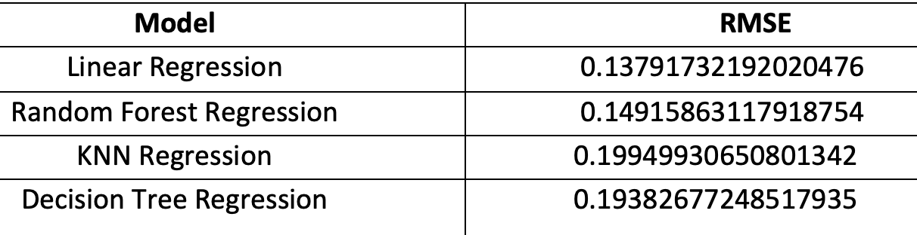
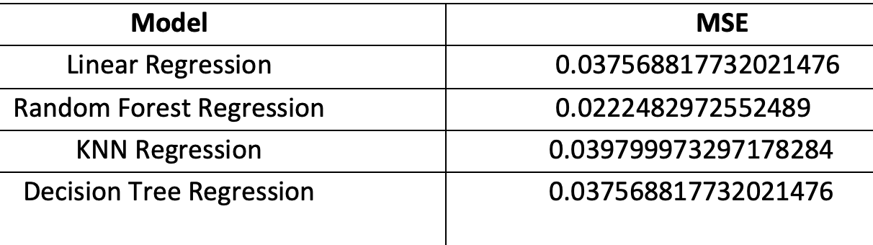
Results
1. R2 Score
3. RMSE
2. MSE

Slide 12
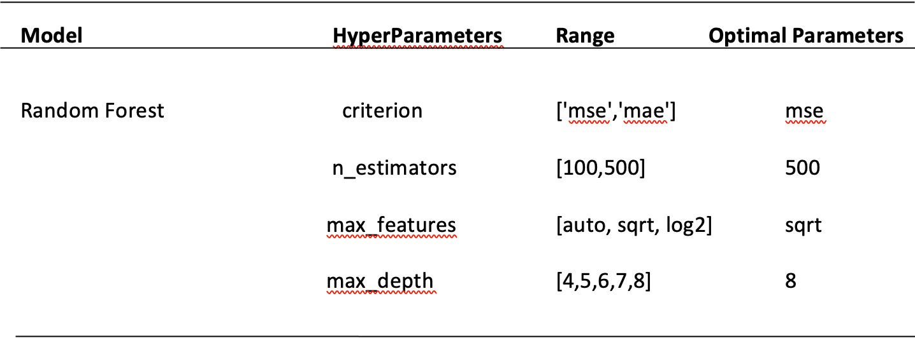
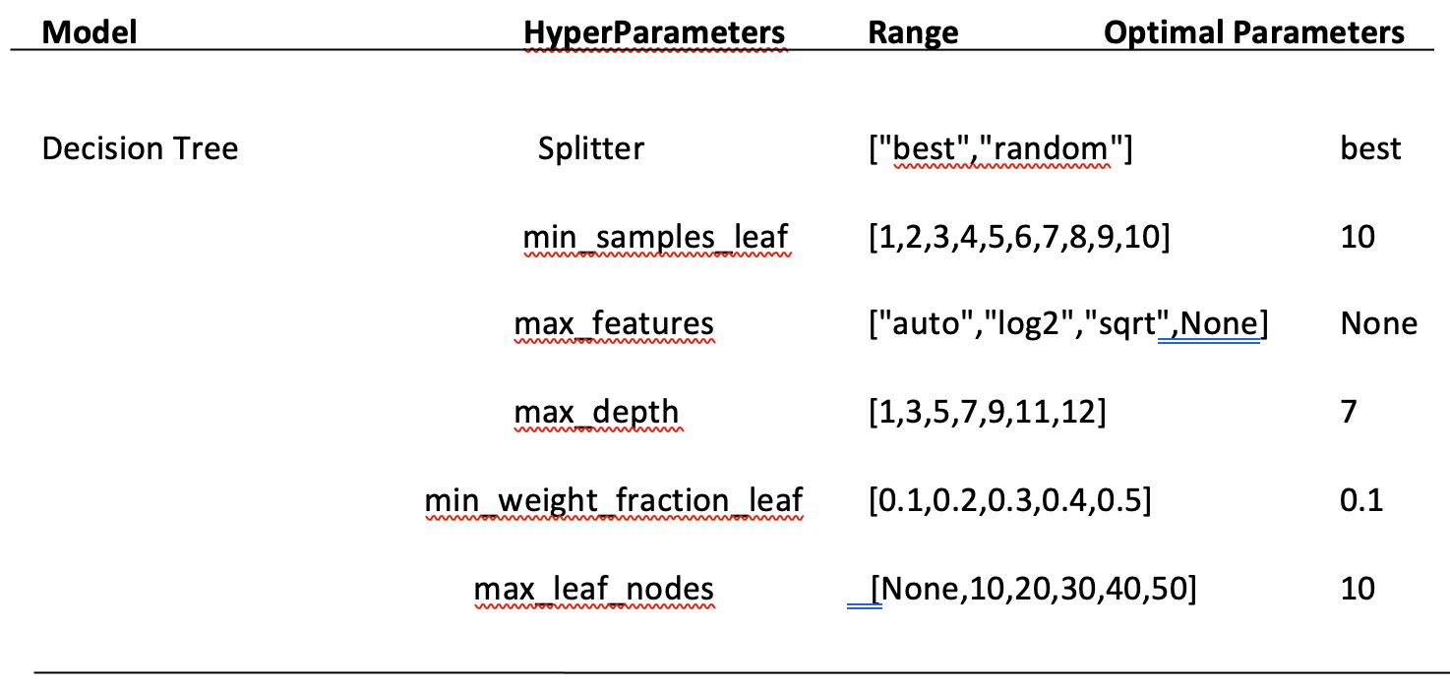
HyperParameter Tuning
1. Random Forest
The r2 score we got after hyperparameter tuning for random forest regressor is 85% which is less than the default parameter model.
So, we choose the Random Forest Classifier with the default value as the best model for prediction.
2. Decision Tree

